Slide 1


Slide 2

Explain why managers are important to organizations
Tell who managers are and where they work
Describe the functions, roles, and skills of managers
Describe the factors that are reshaping and redefining the manager’s job
Explain the value of studying management

Slide 3
Why are Managers Important?
Organizations need their managerial skills and abilities more than ever in these uncertain, complex, and chaotic times.
Managerial skills and abilities are critical in getting things done.
The quality of the employee/supervisor relationship is the most important variable in productivity and loyalty.

Slide 4

Who Are Managers?
Manager
  Someone who coordinates and oversees the work of other people so that organizational goals can be accomplished.

Slide 5
Classifying Managers
First-line Managers - Individuals who manage the work of non-managerial employees.
Middle Managers - Individuals who manage the work of first-line managers.
Top Managers - Individuals who are responsible for making organization-wide decisions and establishing plans and goals that affect the entire organization.

Slide 6
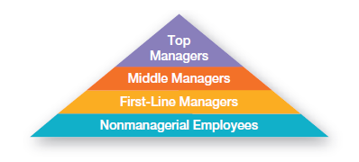
Exhibit 1-1: Levels of Management

Slide 7
Where Do Managers Work?
Organization - A deliberate arrangement of people assembled to accomplish some specific purpose (that individuals independently could not accomplish alone).
Common Characteristics of Organizations
  Have a distinct purpose (goal)
  Are composed of people
  Have a deliberate structure

Slide 8
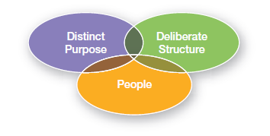
Exhibit 1-2: Characteristics of Organizations

Slide 9
What Do Managers Do?
Management involves coordinating and overseeing the work activities of others so that their activities are completed efficiently and effectively.

Slide 10
Effectiveness and Efficiency
Efficiency
  “Doing things right”
  Getting the most output for the least inputs
Effectiveness
  “Doing the right things”
  Attaining organizational goals

Slide 11
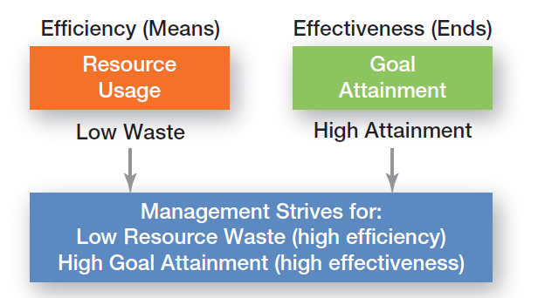
Exhibit 1-3: Efficiency and Effectiveness in Management

Slide 12
Management Functions
Planning - Defining goals, establishing strategies to achieve goals, and developing plans to integrate and coordinate activities.
Organizing - Arranging and structuring work to accomplish organizational goals.
Leading - Working with and through people to accomplish goals.
Controlling - Monitoring, comparing, and correcting work.

Slide 13
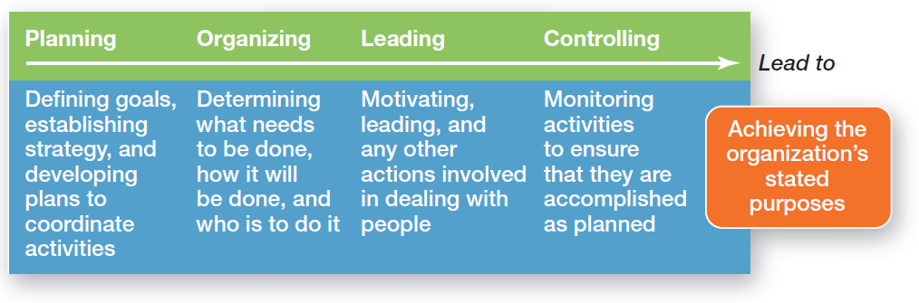
Exhibit 1-4: Four Functions of Management

Slide 14
Management Roles
Roles are specific actions or behaviors expected of a manager.
Mintzberg identified 10 roles grouped around interpersonal relationships, the transfer of information, and decision making.

Slide 15
Management Roles
Interpersonal roles
  Figurehead, leader, liaison
Informational roles
  Monitor, disseminator, spokesperson
Decisional roles
  Entrepreneur, disturbance handler, resource allocator, negotiator

Slide 16
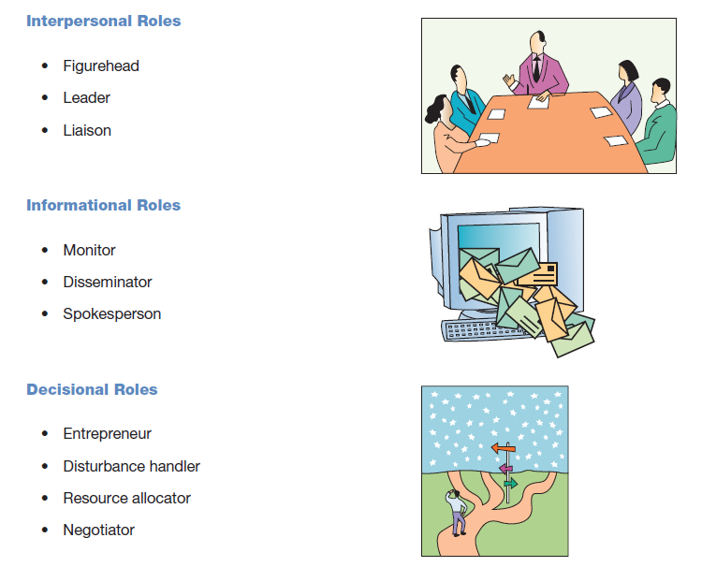
Exhibit 1-5: Mintzberg’s Managerial Roles

Slide 17
Skills Managers Need
Technical skills
  Knowledge and proficiency in a specific field
Human skills
  The ability to work well with other people
Conceptual skills
  The ability to think and conceptualize about abstract and complex situations concerning the organization

Slide 18
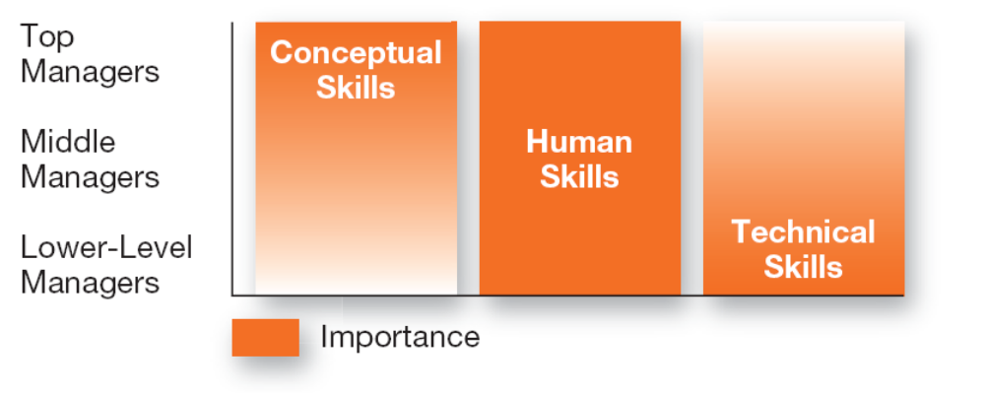
Exhibit 1-6: Skills Needed at Different
Managerial Levels

Slide 19
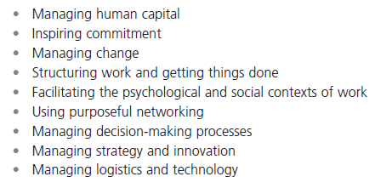
Exhibit 1-7: Important Managerial Skills

Slide 20
The Importance of Customers
Customers: the reason that organizations exist
  Managing customer relationships is the responsibility of all managers and employees.
  Consistent high quality customer service is essential for survival.

Slide 21
The Importance of Innovation
Innovation
  Doing things differently, exploring new territory, and taking risks.
  Managers should encourage employees to be aware of and act on opportunities for innovation.

Slide 22

The Importance of Sustainability
Sustainability -
  a company’s ability to achieve its business goals and increase long-term shareholder value by integrating economic, environmental, and social opportunities into its business strategies.

Slide 23
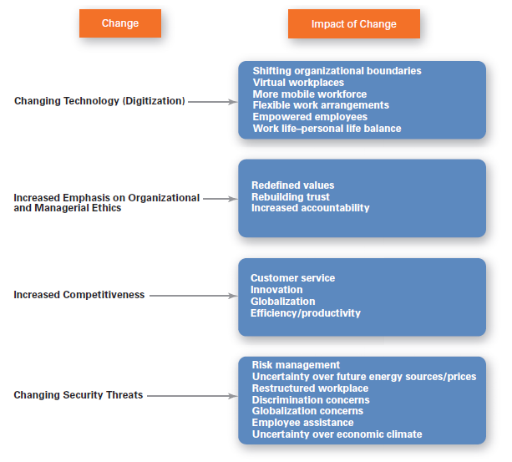
Exhibit 1-8: Changes Facing Managers

Slide 24
Why Study Management?
Universality of Management
  The reality that management is needed
    in all types and sizes of organizations
    at all organizational levels
    in all organizational areas
    in all organizations, regardless of location

Slide 25
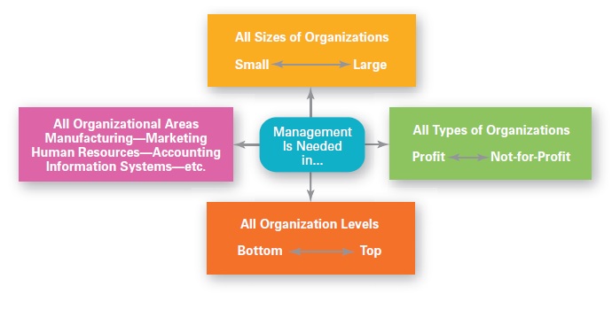
Exhibit 1-9: Universal Need for Management

Slide 26
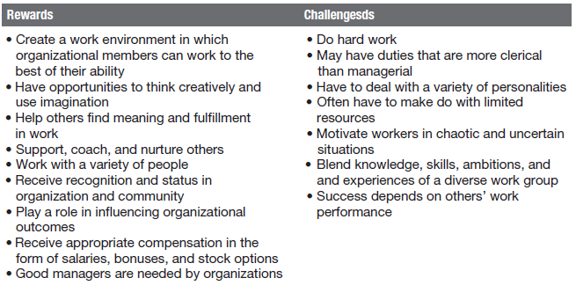
Exhibit 1-10: Rewards and Challenges of Being a Manager

Slide 27
Terms to Know
manager
first-line managers
middle managers
top managers
management
efficiency
effectiveness
planning
organizing
leading
controlling
management roles
interpersonal roles
informational roles
decisional roles
technical skills
human skills
conceptual skills
organization
universality of management

Slide 28
